Slide 1

WAPPS – Web-based Application for a Population Pharmacokinetic Service
Florence, November 4th, 2014
Convegno Triennale AICE
Alfonso Iorio & Massimo Morfini

Slide 2
3 background concepts
Pharmacokinetics (PK) as one of the tool to personalize the clinical management of hemophilia
  Cumbersome to patients and doctors
Population PK (PPK) as a tool to overcome limitations of the standard approach
  Beyond level of expertise of most treaters
WAPPS - “Actively” monitored service
  to overcome difficulties to full automation and
  provide added value to the raw estimation

Slide 3

Population pharmacokinetic
Is it reliable, precise, accurate?
11 data points classic PK
PEAK & TROUGH
PRECISION, ACCURACY

Slide 4
Population pharmacokinetic

Slide 5
Population pharmacokinetic

Slide 6
Population pharmacokinetic

Slide 7
Population pharmacokinetic
11 data points classic PK
PEAK & TROUGH
PRECISION, ACCURACY

Slide 8
Outline -Phases
The Development of the Web-based Application for the Population Pharmacokinetic Service – Hemophilia (WAPPS-Hemo) – Phase 1
The Implementation, User Testing and Validation of the Web-based Application for the Population Pharmacokinetic Service – Hemophilia (WAPPS-HEMO) – Phase 2
Notes:
Not sequential -

Slide 9
WAPPS – Design, methods
Network enterprise
  Development and research
Model building
  Literature data
  Manufacturer data
  Independent PI data
Website building
  Users feed-back

Slide 10
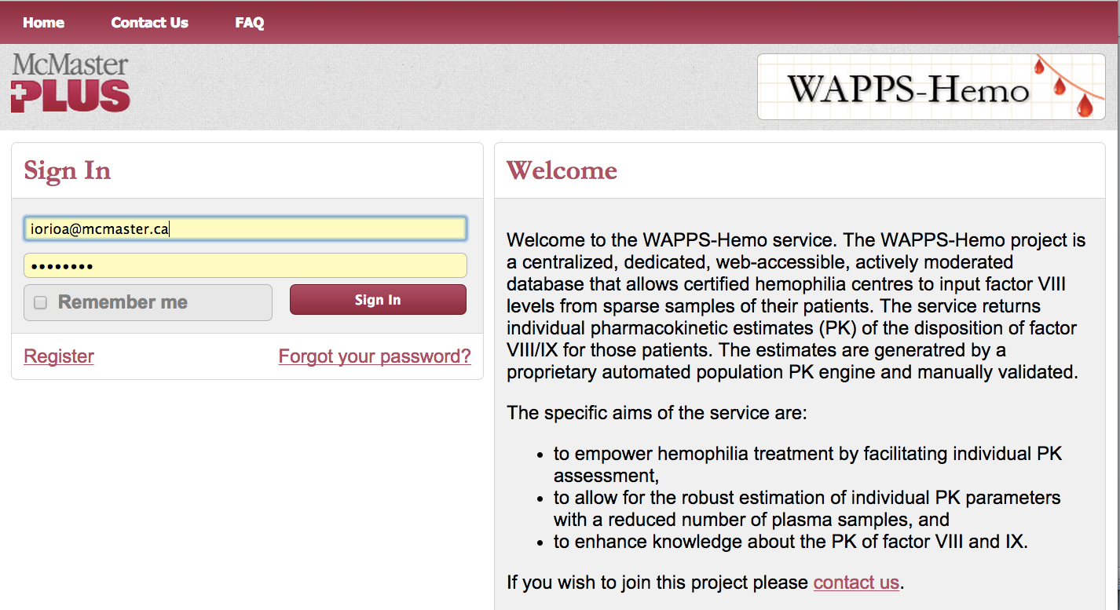
Login page

Slide 11
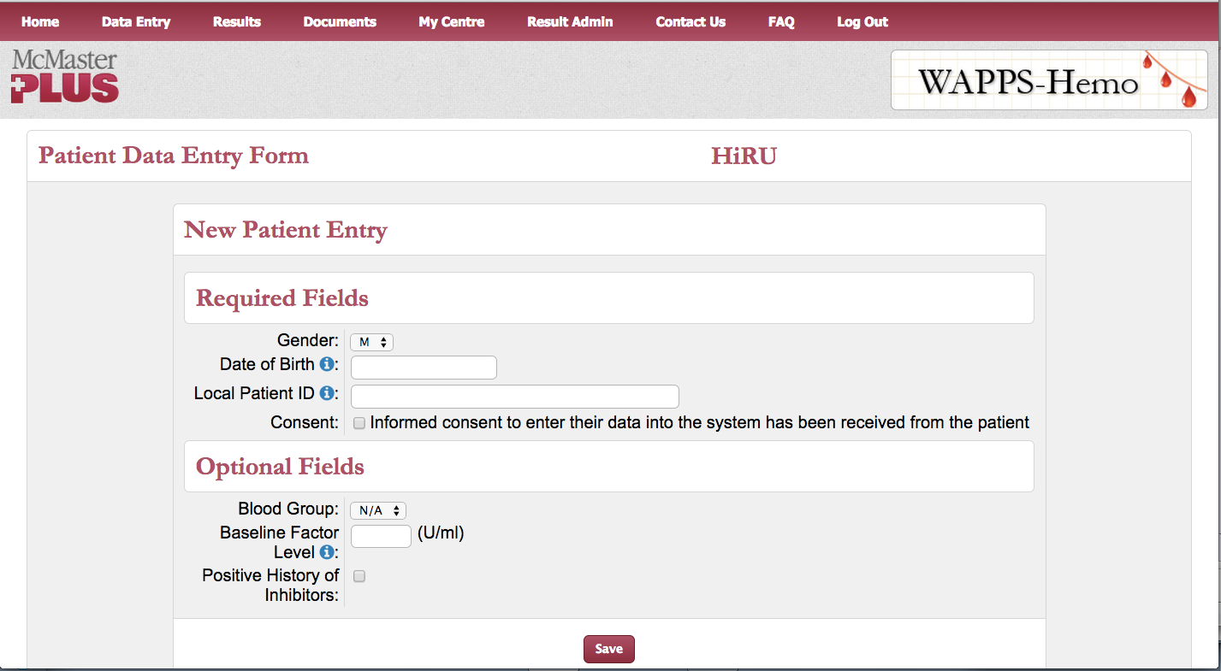
Patient data entry page
Patient data
entry

Slide 12
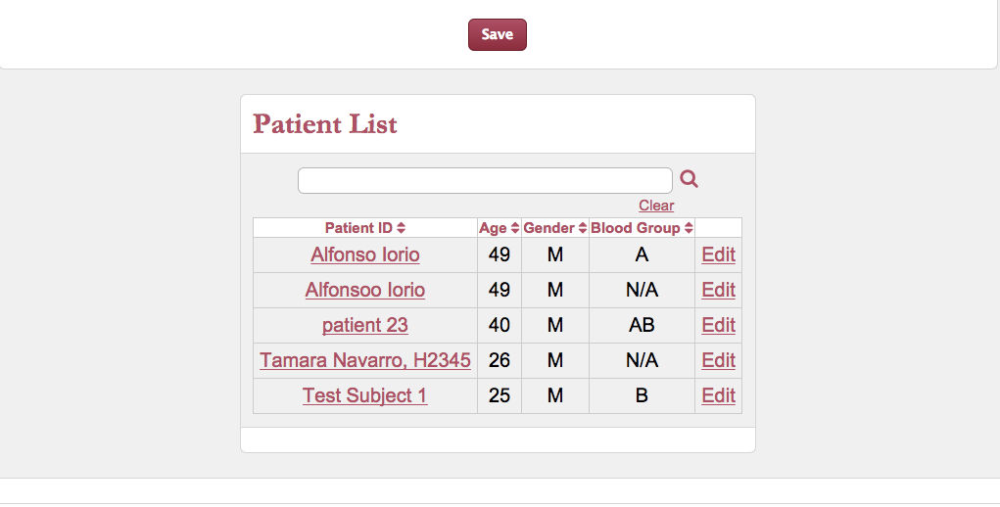
Patient data entry page

Slide 13
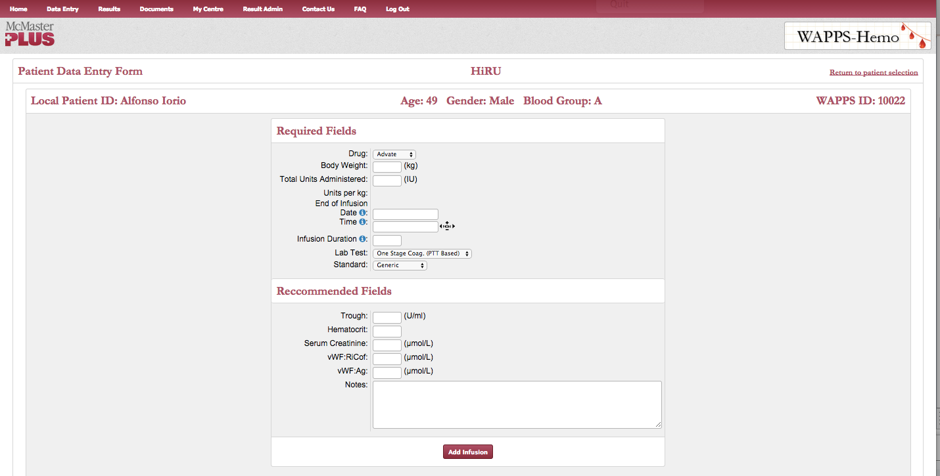
Infusion data entry

Slide 14
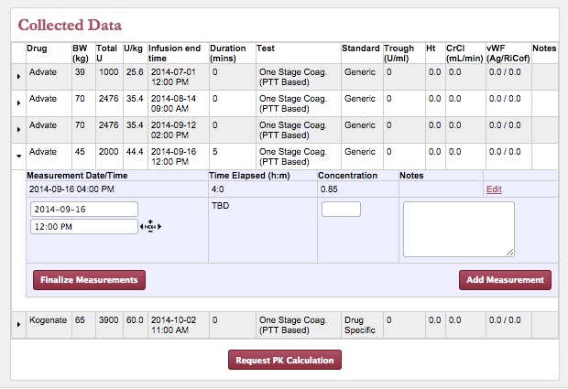

Slide 15
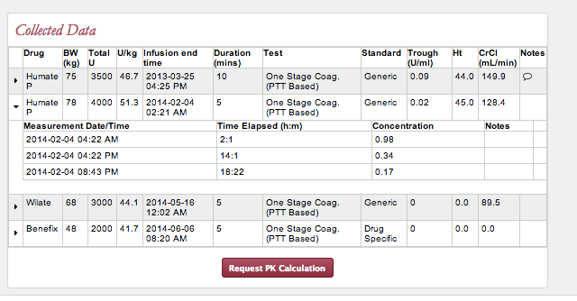
Concentration-time data entry

Slide 16
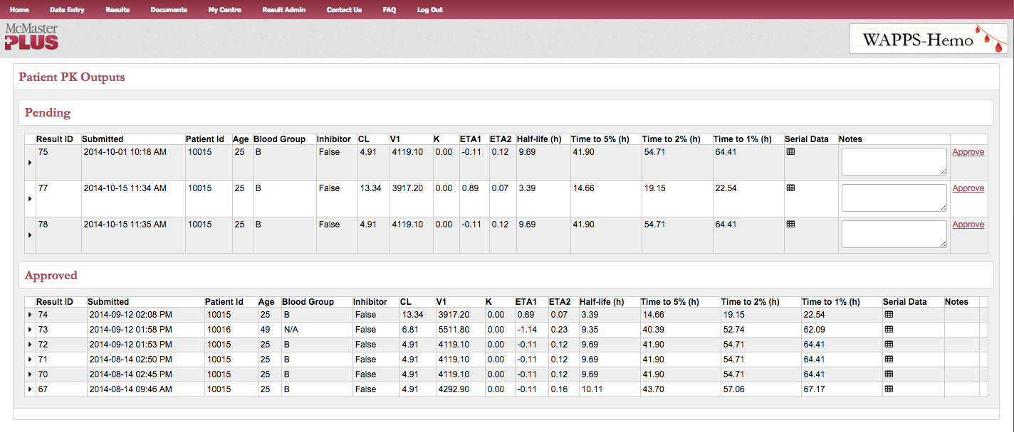
Report validation page

Slide 17
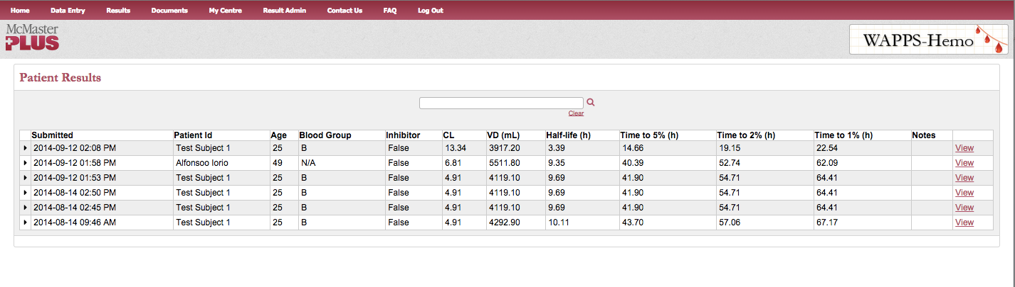
Report list page

Slide 18
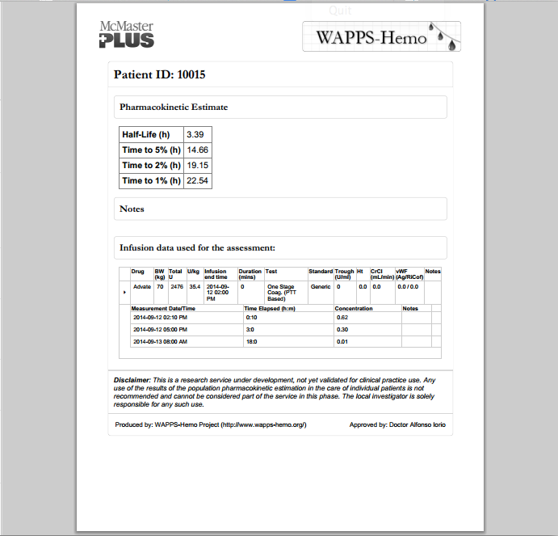
Report page

Slide 19
Contact us
Hemophilia.mcmaster.ca
www.wapps-hemo.org
Tamara Navarro-Ruan <navarro@mcmaster.ca>

Slide 20
Backup slides

Slide 21
Patient 1
Peak, C_{max}, Recovery
CL 1.725
V1 9.560
k 0.055
Half-life (h) 12.5
Concentration (%)
AUC
Half-life
Trough
Time (hours)

Slide 22
Basic Pharmacokinetics
MEASURED
AUC_{last} = measured until the last data point
k = estimated on the last (sole) monotonic curve (C_{t} = C₀ * e^{-kt})
CALCULATED
AUC_{inf} = Calculated starting from AUC_{last} and k
Clearance = Dose / AUC_{inf}
V_{d(ss)} = Clearance/k
MRT=V_{d(ss)}/Cl
T_{1/2}= 0.693/k

Slide 23
Basic Pharmacokinetics
AUC (IU*h dL⁻¹)
Recovery(IVR) (IU dL⁻¹ per IU kg⁻¹)
C_{max} (IU dL⁻¹)
MRT (h)
V_{d(ss)} (dL kg⁻¹)
CL (dL kg⁻¹ h⁻¹)
IVR = (C_{max} (IU dL⁻¹) –C_{pre-inf} (IU dL⁻¹)/ D_{admin} (IU kg⁻¹)

